Slide 1
BOOTCAMP
ACE ENGINEERING COLLEGE
TOPIC : DATA INTELLIGENCE AND AI

Slide 2
Day 3: Spreadsheet Mastery — Loading, Cleaning & Visualizing Data
1. Pandas Foundations
Pandas is a powerful Python library used for working with spreadsheets and tabular data.
Import Pandas
import pandas as pd

Slide 3
Load a CSV File
df = pd.read_csv("sales_data.csv")
View First Few Rows
print(df.head())
Get Dataset Information
print(df.info())

Slide 4
2. Data Manipulation & Cleaning
Real-world datasets often contain:
Missing values
Duplicate records
Incorrect data
Check for Missing Values
print(df.isnull().sum())

Slide 5
Remove Duplicate Rows
df = df.drop_duplicates()
Fill Missing Values with Mean
df['Sales'] = df['Sales'].fillna(df['Sales'].mean())
Fill multiple columns:
df.fillna(df.mean(numeric_only=True), inplace=True)
Verify Cleaning
print(df.isnull().sum())

Slide 6
3. Group Summaries using GroupBy
Suppose we have a dataset:
Department | Salary
HR | 40000
IT | 60000
HR | 45000
IT | 70000

Slide 7
Average Salary by Department
avg_salary = df.groupby('Department')['Salary'].mean()
print(avg_salary)
Multiple Statistics
summary = df.groupby('Department')['Salary'].agg( ['mean', 'max', 'min', 'count']
)
print(summary)

Slide 8
4. Instant Trend Charts with Matplotlib
Import Libraries
import pandas as pd
import matplotlib.pyplot as plt

Slide 9
Line Graph (Trend Over Time)
Month | Sales
Jan | 100
Feb | 150
Mar | 200
Apr | 250

Slide 10
Line Graph (Trend Over Time)
df = pd.read_csv("monthly_sales.csv")
df.plot(
x='Month',
y='Sales',
kind='line',
title='Monthly Sales Trend‘
)
plt.show()

Slide 11
Bar Chart (Category Comparison)
Product | Sales
Laptop | 500
Mobile | 700
Tablet | 300

Slide 12
df.plot(
x='Product',
y='Sales',
kind='bar',
title='Product Sales Comparison‘
)
plt.show()

Slide 13
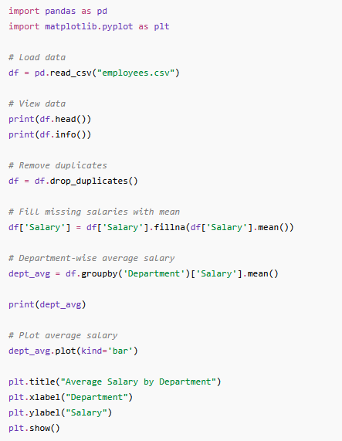
Total code

Slide 14
Employees.csv
EmployeeID | Name | Department | Age | Salary | Experience
101 | Alice | HR | 28 | 50000 | 5
102 | Bob | IT | 25 | 40000 | 6
103 | Charlie | Finance | 26 | 60000 | 9
104 | David | HR | 23 | 30000 | 8
105 | Emma | IT | 25 | 10000 | 7
106 | Frank | Finance | 26 | 80000 | 4
107 | Grace | HR | 28 | 90000 | 56
108 | Helen | Finance | 29 | 15000 | 2
109 | Ian | HR | 25 | 60000 | 5
110 | Jack | Finance | 30 | 15000 | 5
111 | Kate | HR | 25 | 150000 | 2
112 | Liam | IT | 26 | 200000 | 6
113 | Mia | HR | 21 | 30000 | 5
114 | Noa | IT | 24 | 50000 | 4
115 | Olivia | Finance | 23 | 20000 | 8

Slide 15
Sample Dataset for practice
Name | Department | Marks
Alice | CSE | 85
Bob | ECE | 78
Charlie | CSE
David | ECE | 78
David | ECE | 78

Slide 16
Tasks
Load the file.
Display first 5 rows.
Find missing values.
Fill missing marks with average marks.
Remove duplicate rows.
Calculate average marks by department.
Create a bar chart of department-wise average marks.

Slide 17
Step 1: Load the File
import pandas as pd
df = pd.read_csv("students.csv")
print(df)

Slide 18
Step 2: Display First 5 Rows
print(df.head())
Step 3: Find Missing Values
print(df.isnull().sum())
Step 4: Fill Missing Marks with Average
df["Marks"] = df["Marks"].fillna(df["Marks"].mean())
print(df)

Slide 19
Step 5: Remove Duplicate Rows
df = df.drop_duplicates()
print(df)
Step 6: Calculate Average Marks by Department
dept_avg = df.groupby("Department")["Marks"].mean()
print(dept_avg)
Step 7: Create a Bar Chart
import matplotlib.pyplot as plt
dept_avg.plot(
kind="bar",
title="Average Marks by Department“
)
plt.xlabel("Department")
plt.ylabel("Average Marks")
plt.show()

Slide 20
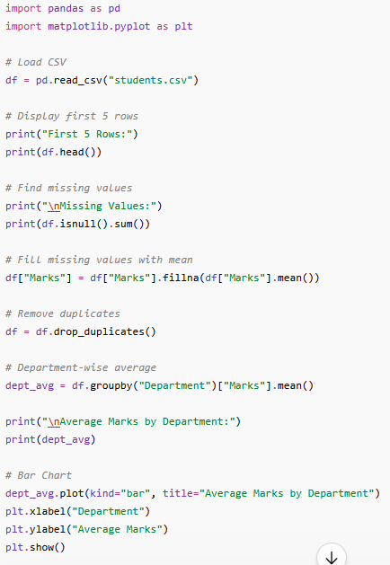
Total code

Slide 21
Assignment: The 5-Year Corporate Sales Audit & Performance Trend Dashboard
Tasks and Solutions
Task 1: Load the Dataset
import pandas as pd
df = pd.read_csv("corporate_sales.csv")
print(df.head())

Slide 22
Task 2: Inspect Dataset Structure
print(df.info())
Task 3: Detect Missing Values
print(df.isnull().sum())
Task 4: Fill Missing Values
df["Sales"] = df["Sales"].fillna(df["Sales"].mean())df["Profit"] = df["Profit"].fillna(df["Profit"].mean())
print(df.isnull().sum())

Slide 23
Task 5: Remove Duplicate Records
print("Before:", len(df))
df = df.drop_duplicates()
print("After:", len(df))
Task 6: Calculate Average Sales by Region
region_sales = df.groupby("Region")["Sales"].mean()
print(region_sales)
Task 7: Calculate Average Profit by Region
region_profit = df.groupby("Region")["Profit"].mean()
print(region_profit)

Slide 24
Task 8: Total Sales by Year
yearly_sales = df.groupby("Year")["Sales"].sum()
print(yearly_sales)
Task 9: Create Sales Trend Line Chart
import matplotlib.pyplot as plt
yearly_sales.plot(
kind="line",
marker="o",
title="Company Sales Trend (2020-2024)“
)
plt.xlabel("Year")
plt.ylabel("Total Sales")
plt.grid(True)
plt.show()

Slide 25
Task 10: Create Regional Sales Comparison Bar Chart
region_sales.plot(
kind="bar",
title="Average Sales by Region“
)
plt.xlabel("Region")
plt.ylabel("Average Sales")
plt.show()

Slide 26
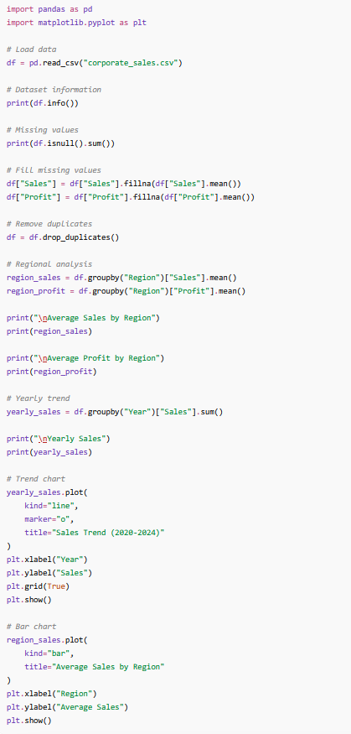

Slide 27
Git
git clone https://github.com/codingacharya/assignment3.git
cd assignment3
pip install -r requirements.txt
streamlit run app3.py
or
python assignment3.py

